Slide 1

CAF Hackathon Advanced
Session 3 – Network, Management and Monitoring

Slide 2
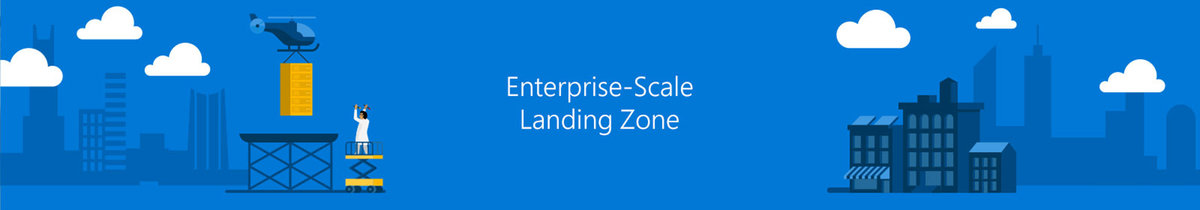
Photo layout 1
Network Topology and Connectivity

Slide 3
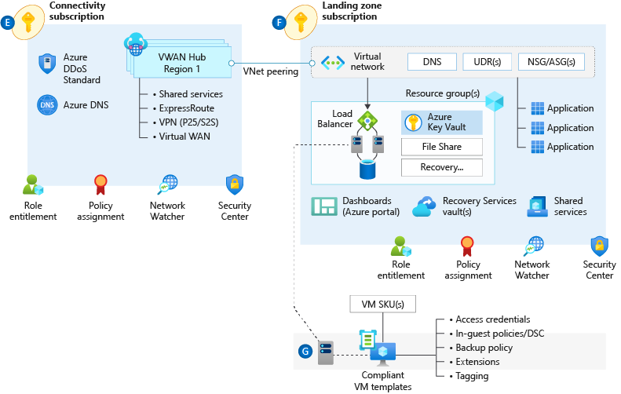

Network Topology & Connectivity
Consider the following design elements:
IP Address planning
Configure DNS
Define Azure Network topology
Azure Virtual WAN (Microsoft Managed)
Traditional Azure networking (Customer Managed)
Connectivity to Azure
Overview
Segmentation
Encryption
Traffic Inspection

Slide 4

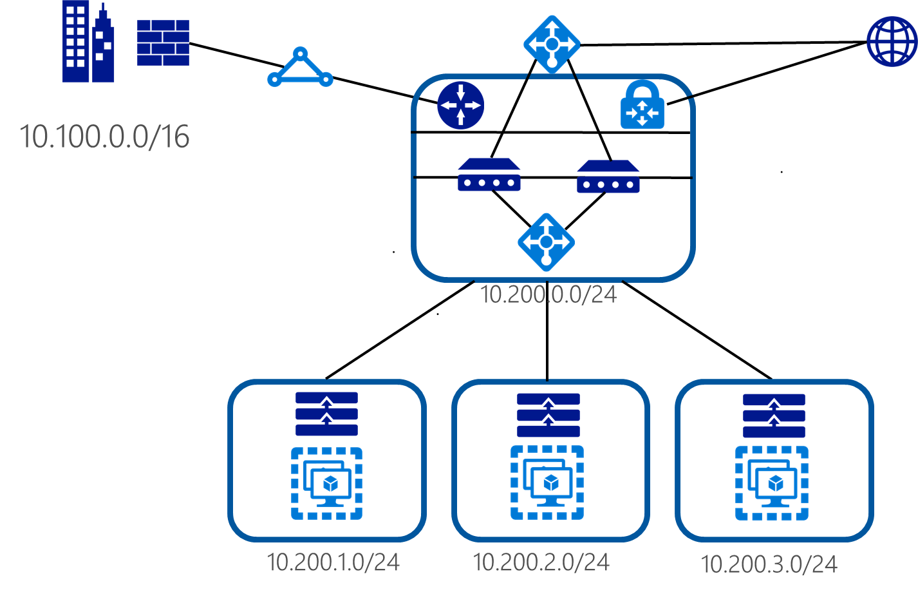
Network Topology & Connectivity
Azure Region = 10.200.0.0/16
IP Addressing

Slide 5
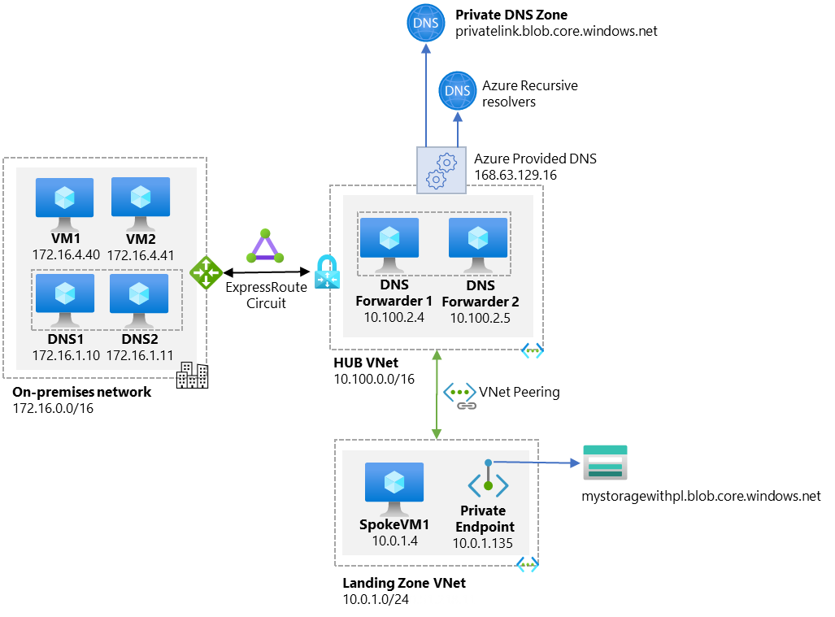
Network Topology & Connectivity
Example: DNS resolution flow when a VM in a VNET tries to resolve private endpoint:
DNS

Slide 6
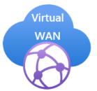
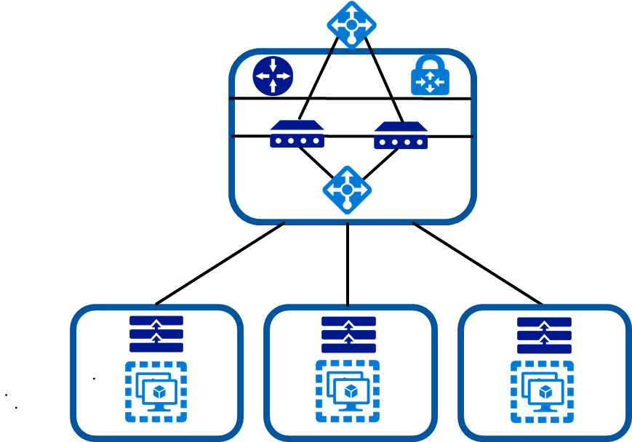
Network Topology & Connectivity
Choose the right technologies and topology approaches for Azure deployments
Is there a need for branch-to-branch connectivity?
Define an Azure Networking Topology
Is there a need granular control of connectivity?

Slide 7
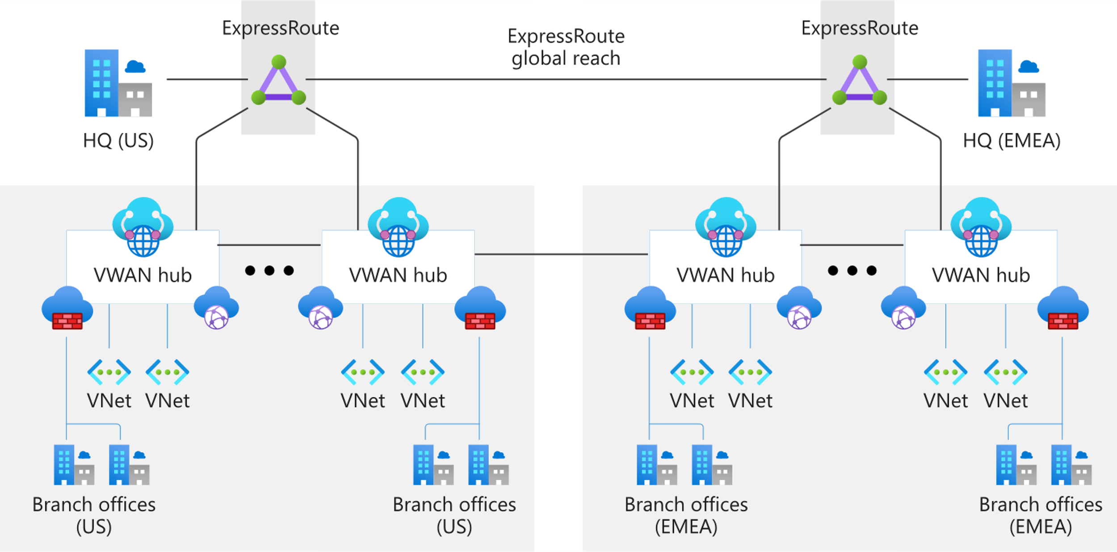
Network Topology & Connectivity
Virtual WAN Global Transit Network
Virtual WAN

Slide 8
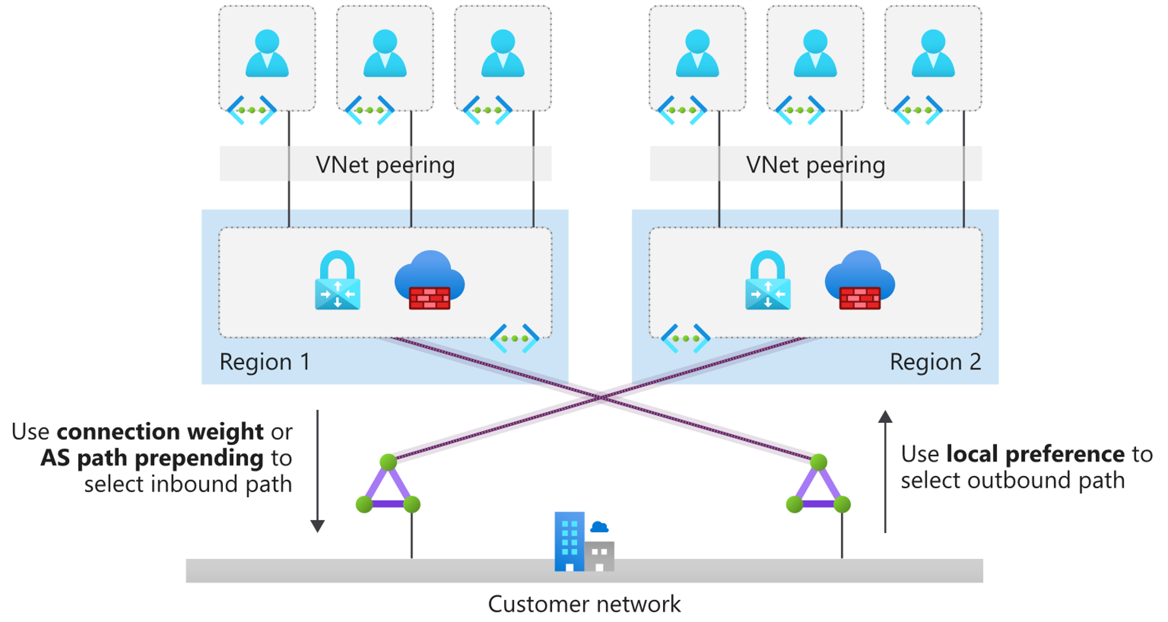
Network Topology & Connectivity
Traditional Hub and Spoke

Slide 9
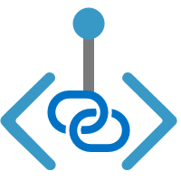
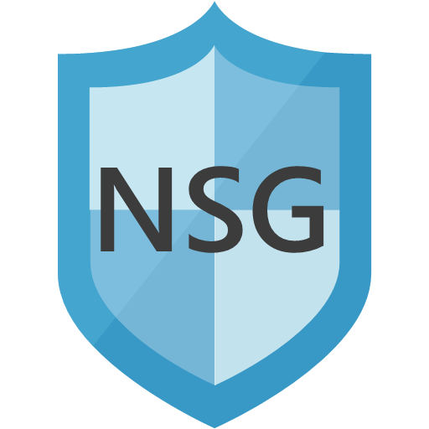
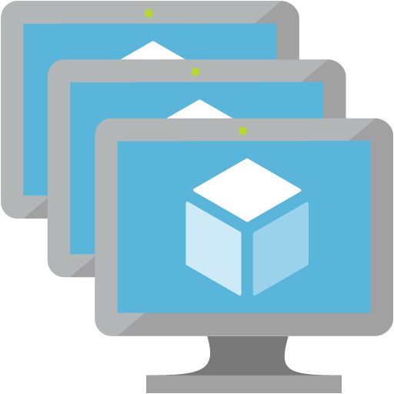



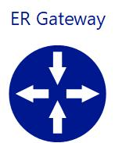



Network Topology & Connectivity
Private Link
Deny Outbound: Internet
Deny Inbound: Internet
Private Link
Internet non-routable Private IP
Private IP
Private Endpoint
Private Link Service
ILB
application VMs
Service Consumer
Service Provider
ER PrivatePeering
AD Tenant A; Subscription A
AD Tenant B; Subscription B
Connectivity to
PaaS services
On-premises

Slide 10
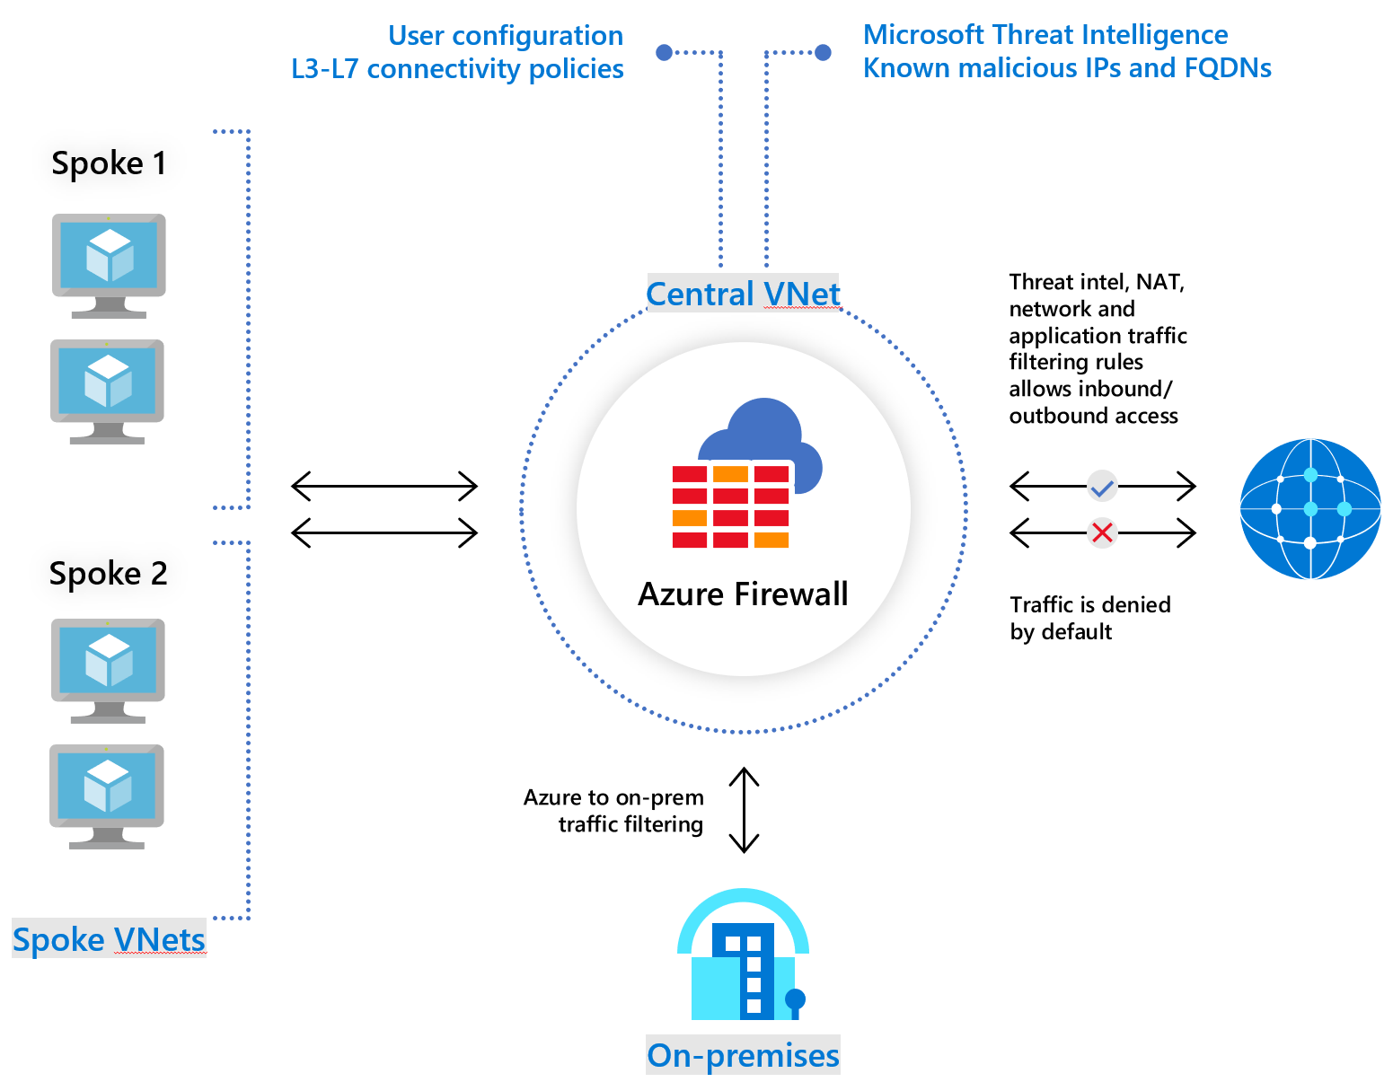
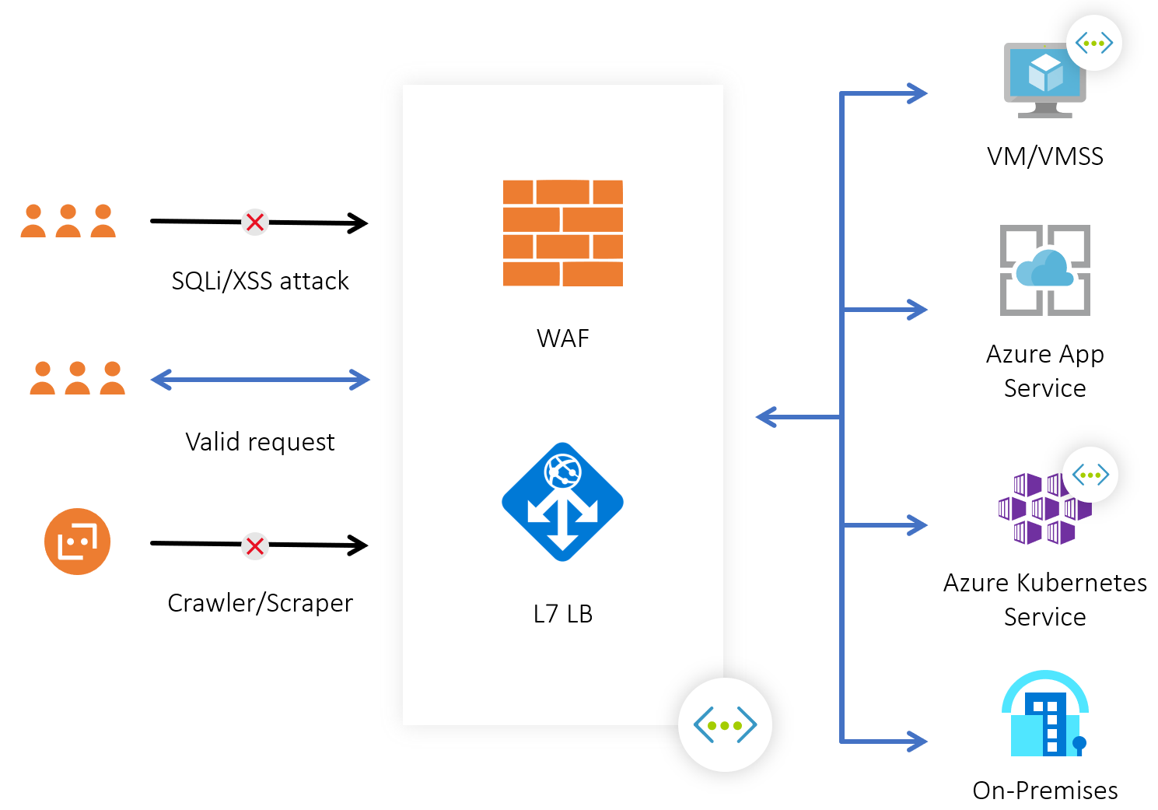
Network Topology & Connectivity
Azure Firewall and WAF
Internet
Connectivity

Slide 11
Network Topology & Connectivity
Landing zone owners should be able to create subnets and manage NSGs
Use NSG flow logs and traffic analytics
Use ASGs for intra-vnet controls
Inter-landing zone traffic can be NSG, Azure Firewall or NVA
Deploy WAFs inside landing zones
Segmentation

Slide 12
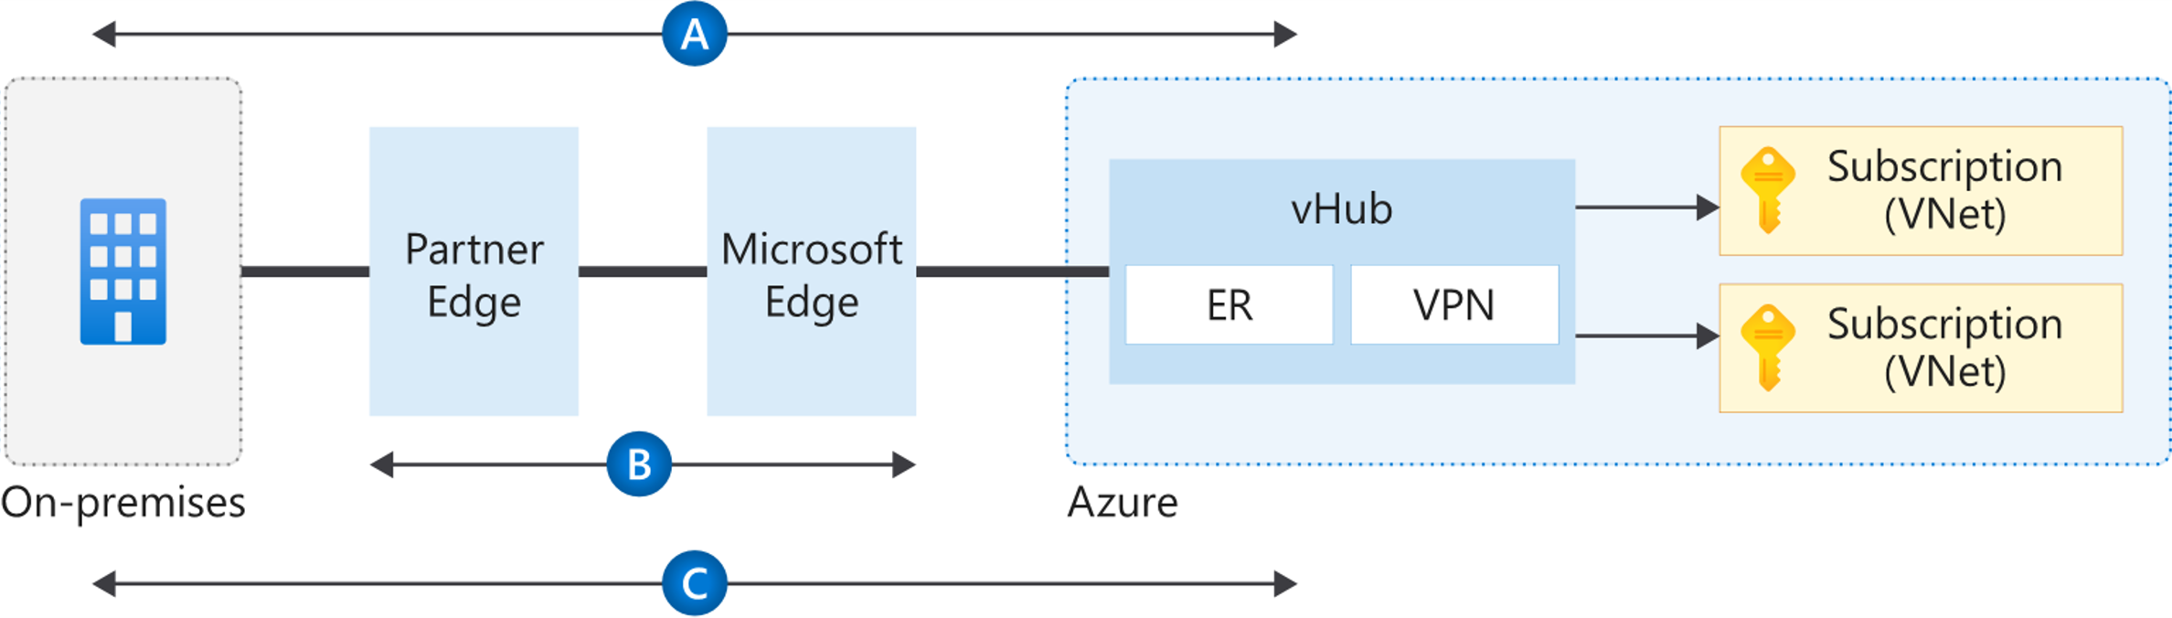
Network Topology & Connectivity
VPN connection by using IPsec (A)
Use MACsec for ExpressRoute Direct customers (B)
IPsec over ExpressRoute private peering for virtual WAN (C)
VNET to VNET VPN Gateways for inter-landing zone encryption
Encryption Options

Slide 13
Network Topology & Connectivity
Use Network Watcher packets to capture despite the limited capture window.
Evaluate whether the latest version of NSG flow logs provides the level of detail that you need
Use partner solutions for scenarios that require deep packet inspection
Don't develop a custom solution to mirror traffic. Complexity and supportability issues may arise.
Traffic Inspection

Slide 14
Network Topology & Connectivity
GitHub
Deploy Enterprise-Scale Reference implementation in your own environment
Landing Zone
Full enterprise-scale landing zone networking documentation
DNS
Azure Private Endpoint DNS configuration
Azure DNS Private Zones scenarios
Topology
Network Virtual Appliance (NVA) routing
Migrate to Azure Virtual WAN
Azure Virtual WAN limits
Azure subscription and service limits
Connectivity
ExpressRoute
ExpressRoute Direct
Configure Network Performance Monitor for ExpressRoute
ExpressRoute connectivity partners and peering locations
Segmentation
Network security groups
What is Azure Firewall?
Encryption
Configure MACsec on ExpressRoute Direct ports
Learn more

Slide 15
Photo layout 1
Critical Design Area – Management & Monitoring
Notes:
Maria

Slide 16

Management & Monitoring
Why do we talk about this?
Notes:
Maria
Wie erreichen zentralisierter Verwaltung und Überwachung auf Plattformebene im laufenden Betrieb
wichtige Empfehlungen für zentrale Teams, informationen die sie brauchen und sicherstellen, dass vorgaben eingehalten werden

Slide 17
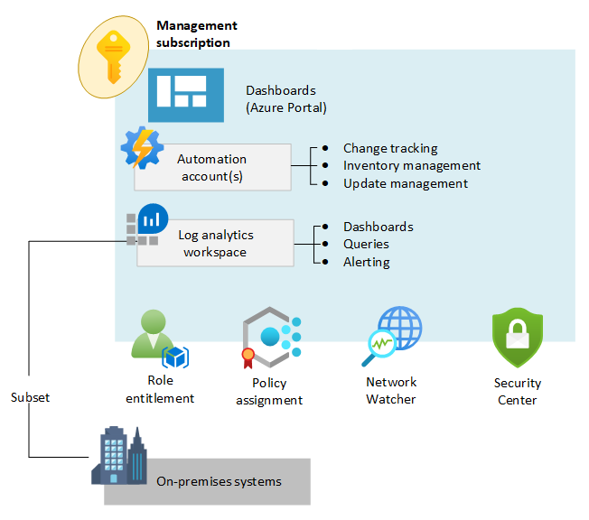
Management & Monitoring
Overview
Notes:
Maria
Management subscription mit zentralen funktionalitäten gebündelt zur verfügung zur stellen
Greift auf native Azure funktionalitäten zurück
Sicherlich design anforderungen die 3 anbieter oder andere lösungen mit sich bringen, aber wir fokussieren uns auf die azure werkzeuge
Viele der Themen haben sie schon gehört:
Role Entitlement – granulare rechte vergabe, zugang für die richtige person auf dem richtigen scope – identity
In diesem rahmen – centrale it visibilität auf die platform haben, sprich logs, patching status und security alerts
Policy Assignment wurde in management group und subscription slot besprochen, aber auch heute warden wir noch einmal auf das thema eingehen um sicherzustellen, das ein ganzheitliches monitoring und management durch centrale it gewährleistet ist
Inhaltlich einsteigen mit einem der wichtigsten werkzeuge rund ums thema monitoring: Azure monitor

Slide 18
E - Management and Monitoring
1. Planning for Platform Management and Monitoring
Use a single Log Analytics workspace for centralized platform management except where RBAC, retention of data types and data sovereignty requirements mandate the consideration of separate workspaces. Export logs to Azure Storage if log retention requirements exceed 2 years. Leverage immutable storage with WORM policy (Write Once, Read Many) to make data non-erasable and non-modifiable for a user-specified interval. Use Azure Policy for access control and compliance reporting. This provides the ability to enforce the settings across an organization to ensure consistent policy adherence and fast violation detection, as described in this article. Monitor in-guest VM configuration drift using Azure Policy. Enabling guest configuration audit capabilities through policy provides application teams with the ability to immediately consume the feature capabilities for their workloads with very little effort. Use Update Management in Azure Automation as a long-term patching mechanism, for both Windows and Linux VMs. Enforcing configuration of update management through policy ensures all VMs are included in the patch management regimen, provides application teams with the ability to manage patch deployment for their VMs, and provides central IT with visibility and enforcement capabilities across all VMs. Use Azure Network Watcher to proactively monitor traffic flows via NSG Flow Logs v2. Use deny policies to supplement Azure RBAC assignments. Include Service and Resource Health events as part of the overall platform monitoring solution. Do not send raw logs entries back to on premise monitoring systems, but instead adopt the principal of "data born in Azure, stays in Azure". If on-premises SIEM integration is required send critical alerts instead of logs
Design Decision
Use dedicated subscription for management, separated from app landing zones | Subscription Name
Use Azure native/first-party monitoring & management services | Yes
Data retention | 1 year
Log Workspace name | Name of Log Analytics Workspace
Azure region for the Log Analytics workspace | Region
Automation account name | Name of automation account
Azure region for the automation account | Region
Solutions enabled for the workspace, such as Sentinel | List of Solutions
RBAC model for Workspace: Centric vs resource centric | Resource centric
Azure Policies to ensure auditing, security, diagnostics and metrics from platform perspective | ASC monitoring, diangostics, activity logs, VM extension etc.
Delegate update management to application owners | Yes
Notes
Notes:
Document the customers decisions based on Enterprise-scale considerations and recommendations within each template.

Slide 19
E - Management and Monitoring
1. Planning for Application Management and Monitoring
Application monitoring can use dedicated Log Analytics workspaces. For applications that are deployed to virtual machines, logs should be stored centrally to the dedicated Log Analytics workspace from a platform perspective, and application teams can access the logs subject to the RBAC they have on their applications/virtual machines. Use Azure Monitor Metrics for time sensitive analysis. Use shared storage accounts within the "Landing Zone" for Azure Diagnostic Extension log storage when required. Leverage Azure Monitor Alerts for the generation of operational alerts.
Design Decision
Allow app owners to create/use their own monitoring tools within the Landing Zone (RBAC) | Yes, using Custom Roles
Azure Policies to provide built-in monitoring, security and auditing for applications | Yes, providing baseline for resources within scope
Notes
Notes:
Document the customers decisions based on Enterprise-scale considerations and recommendations within each template.

Slide 20

Photo layout 1
Azure Monitor
Notes:
Maria
Azure Monitor ist das Werkzeug zum Sammeln und Umgang mit Monitoring daten – was bedeutet das

Slide 21


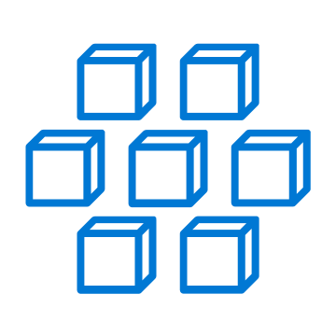
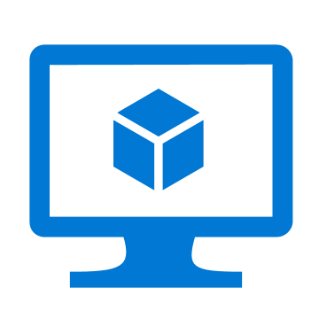
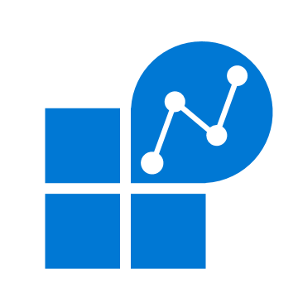
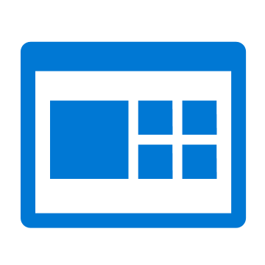










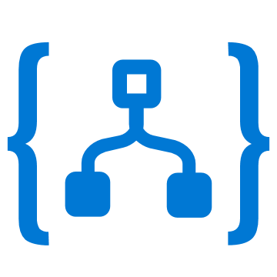
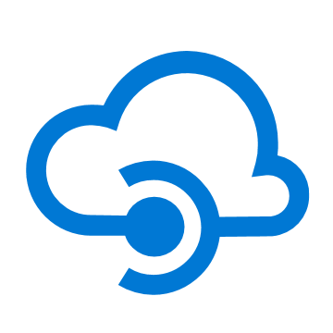
Azure Monitor
Insights
Application
Container
VM
Monitoring Solutions
Application
Operating System
Visualize
Metrics
Dashboards
Views
Power BI
Workbooks
Azure Resources
Azure Subscription
Analyze
Logs
Metrics Explorer
Log Analytics
Azure Tenant
Respond
Custom Sources
Alerts
Autoscale
Integrate
Event Hubs
Logic Apps
Ingest & Export APIs
Notes:
Maria
Retention Azure Monitor Logs beträgt 30 Tage max 2 Jahre, Azure AD-Berichte (Premium) beträgt 30 Tage, Azure-Diagnosedienst beträgt 90 Tage.
Wie ist das ganze konzeptionell aufgebaut – links die daten quellen, beispielsweise resourcen informationen wie service health oder activity logs für die änderungen an ihren resourcen
2 arten daten metric also numerisch cpu auslastung und logs Protokolldaten zum beispiel wenn ein fehler aufgetreten ist
Wir sprechen gleich auch nochmal darüber wo diese daten abgelegt werden, aber durch verarbeitung und sichtbarkeit ist azure monitor der zentrale ort um all die daten einzusehen
Auf der rechten seite sehen wir, was für funktionalitäten im monitor sind, integrieren die daten weiter verarbeiten, reaction alamieren lassen und aktionen darauf folgen lassen, weiter analysieren ursachenforschung, darstellen

Slide 22



Data Collection & Onboarding
Application
Application Insights SDK/Agent
Multi-Language Support
Azure Monitor
Infrastructure
Agents
Windows + Linux Support
Workload Agnostic
Metrics
Azure Resources
Azure Subscription
Zero Instrumentation
Logs & Metrics
Logs
Azure Tenant
Custom Sources
REST APIs
https://docs.microsoft.com/de-de/azure/azure-monitor/platform/data-sources
Notes:
Maria
Abhanging von resource unterschiedliche wege an die daten zu kommen beispielsweise application insights für applications, unterschiedliche agents für infrastruktur also ihre windows vm oder linuxvm
For capturing operating system data such as syslog, you can install a Windows/Linux agent.
Logs und metriken ohne das sie etwas dafür tun müssen, wenn alles konfiguriert können sie zentral darauf zugreifen. Activity log, wenn sie eine neue resource anlegen

Slide 23

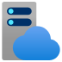

Changes in monitoring
Traditional monitoring
Azure Monitor – Continuous Monitoring across app, infra and network
DevOps/SRE culture
App
Developers
Apps
Developers
Azure Monitor
IT Ops
Infrastructure
IT Ops
Analytics and AI
Infra
Network Admins
Network
Network Admins
Network
Notes:
Maria
Traditional heransgehenweise, war spezielle rollen und spezielle monitoring werkzeuge, ändert sich in der cloud, stellen das ganze set an monitoring zur verfügung

Slide 24
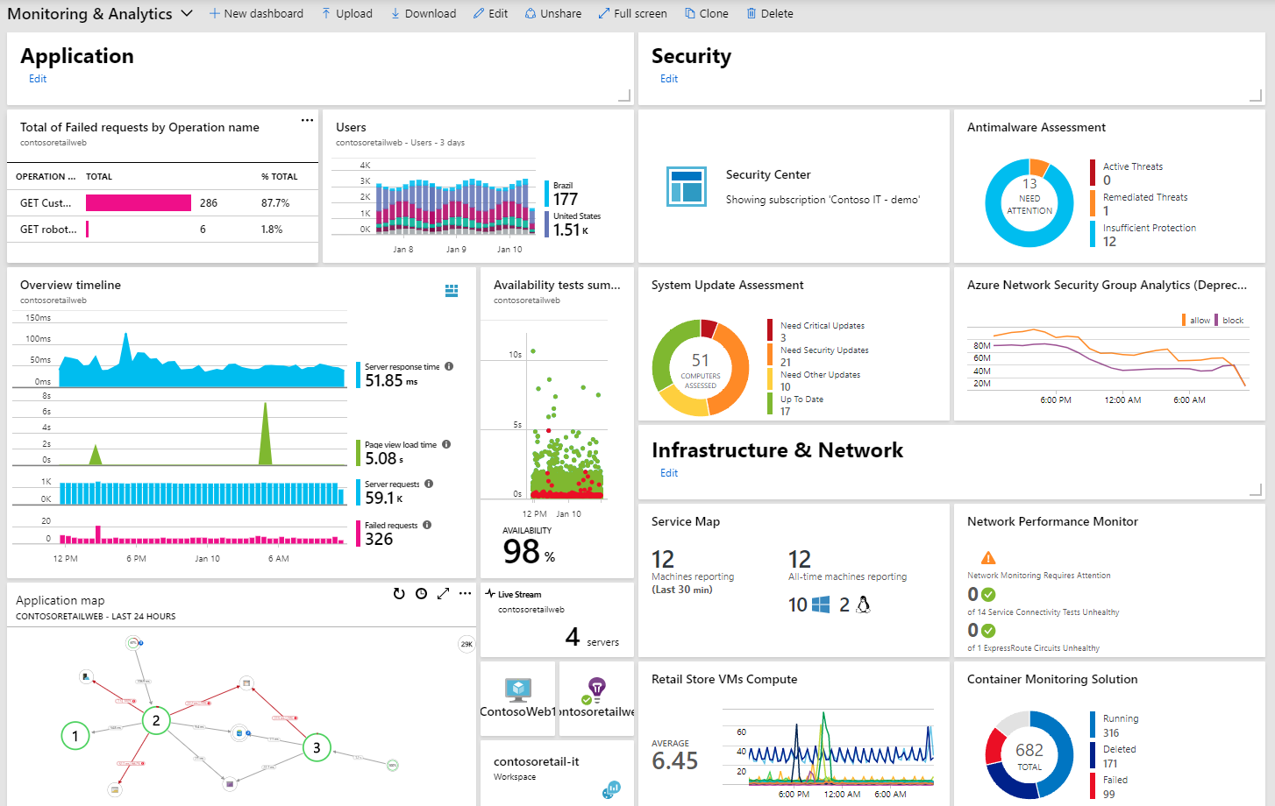
Azure Dashboards
organized view of your cloud resources in the Azure portal
Notes:
Maria
Visualisieren von metricen und logs angesprochen
Dashboards darstellung und zur verfügung stellen

Slide 25
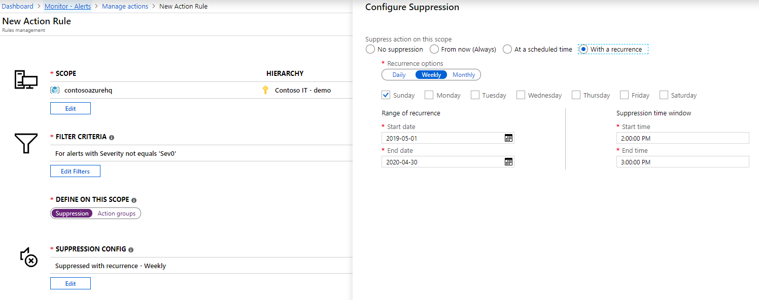
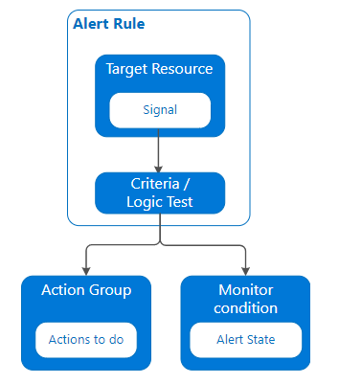
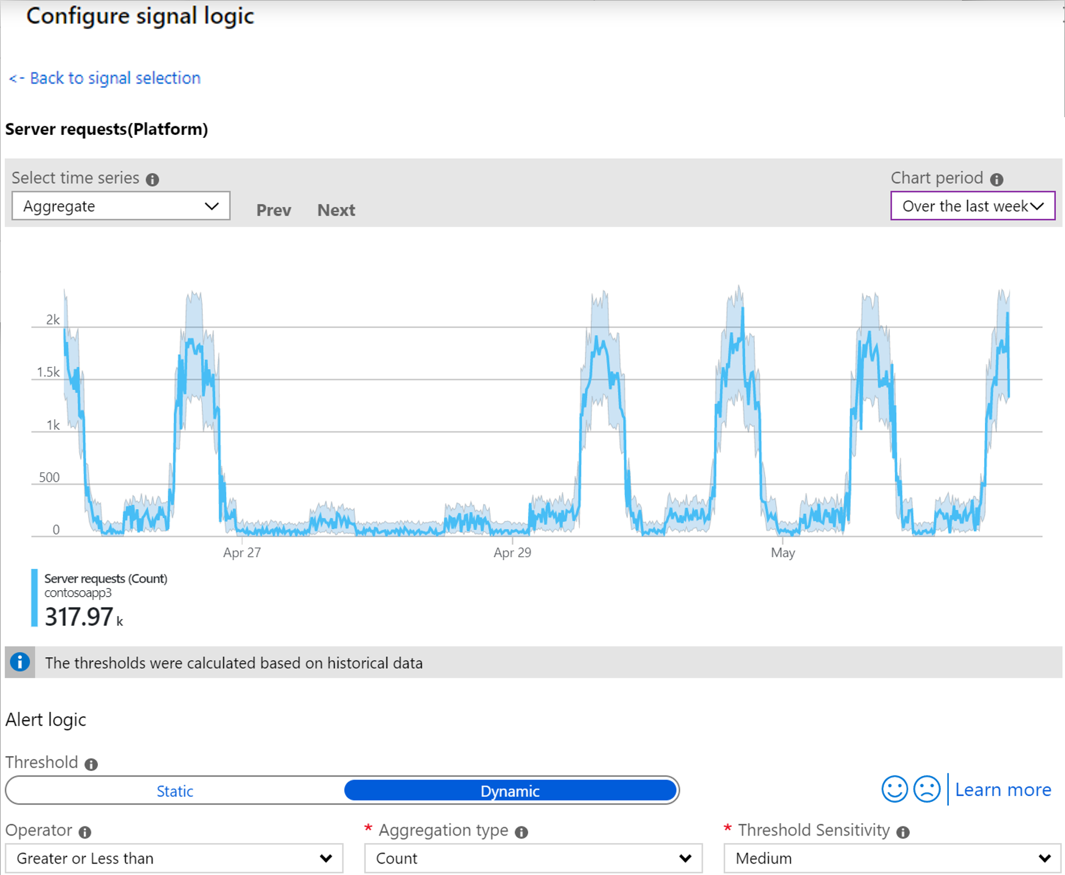
Alerting
proactively notify you when issues are found with your infrastructure or application using your monitoring data in Azure
Notes:
Maria
Thema response – alerting ziel ist mitteilung über ein autretendes event, so kann man sich wie auf der linken seite dargestellt einen alert erstellen, auf einer bestimmen resource muss ein criterium erfüllt sein und dann, kann man in einer action group definieren was passion soll

Slide 26
Photo layout 1
Log Analytics
Notes:
Maria

Slide 27
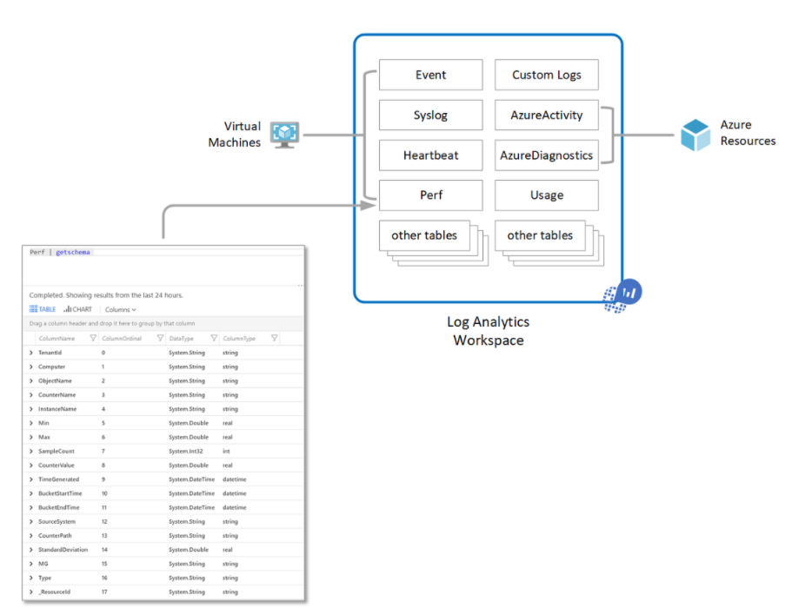
Log Analytics Workspace
A geographic location for data storage
Data isolation by granting different users access rights
Scope for configuration of settings like pricing tier, retention, and data capping
Notes:
Maria
Retention Azure Monitor Logs beträgt 30 Tage max 2 Jahre, Azure AD-Berichte (Premium) beträgt 30 Tage, Azure-Diagnosedienst beträgt 90 Tage.
Log Analytics werkueig mit dem man abfragen (queries) auf die logs macht diese warden auch vom Azure monitor verwendet
Wenn wir über azure monitor sprechen müssen wir auch über log analytics sprechen. In einem log analytic workspace warden ihre logs gespeichert die azure monitor verwendet, hier sehen wir auch schon welche daten in diesem log analtics workspace gespeichert warden, ihre events, performance daten , azure acitivtäten, hier wird auf die isolation der daten hingewiesen, darauf sollten wir genauer eingehen

Slide 28
Log Analytics Workspaces Deployment Models
Centralized: | Decentralized: | Hybrid:
All logs are stored in a central workspace and administered by a single team, with Azure Monitor providing differentiated access per-team. | Each team has their own workspace created in a resource group they own and manage, and log data is segregated per resource. | Security audit compliance requirements further complicate this scenario because many organizations implement both deployment models in parallel.
Notes:
Maria
Wie organisiert man nun den oder die log analytics workspaces, es gibt 3 modelle je nach anforderung, zudem sprechen wir danach über die zugriffs modelle
Also zunächst workspace
Zentral, alle daten in einen, wenn das monitoring durch ein team adminisitrert wird
Dezentral, wenn jedes team seine eigenen resourcen überwacht und hybrid, wenn auf grund von datenschutz bestimmung beispielsweise in eine geolocation,
Wichtig ein windows agent kann bis zu 4 workspaces reporten

Slide 29
Log Analytics access mode
 | Workspace-context | Resource-context
Who is each model intended for? | Central administration. Administrators who need to configure data collection and users who need access to a wide variety of resources. Also currently required for users who need to access logs for resources outside of Azure. | Application teams. Administrators of Azure resources being monitored.
What does a user require to view logs? | Permissions to the workspace. | Read access to the resource.
What is the scope of permissions? | Workspace. Users with access to the workspace can query all logs in the workspace from tables that they have permissions to. | Azure resource. User can query logs for specific resources, resource groups, or subscription they have access to from any workspace but can't query logs for other resources.
How can user access logs? | Start Logs from Azure Monitor menu. Start Logs from Log Analytics workspaces. From Azure Monitor Workbooks. | Start Logs from the menu for the Azure resource Start Logs from Azure Monitor menu. Start Logs from Log Analytics workspaces. From Azure Monitor Workbooks.
Notes:
Maria
Wo die daten liegen workspace bezogen und jetzt wie können die nutzer darauf zugreifen
2 ausprägungen: workspace context rbac auf dem workspace, kann alles darin sehen kann alle logs abfragen oder resourcen context, für ihr applications team, kann alle logs der resourcen sehen auf die er7sie zugriff hat

Slide 30
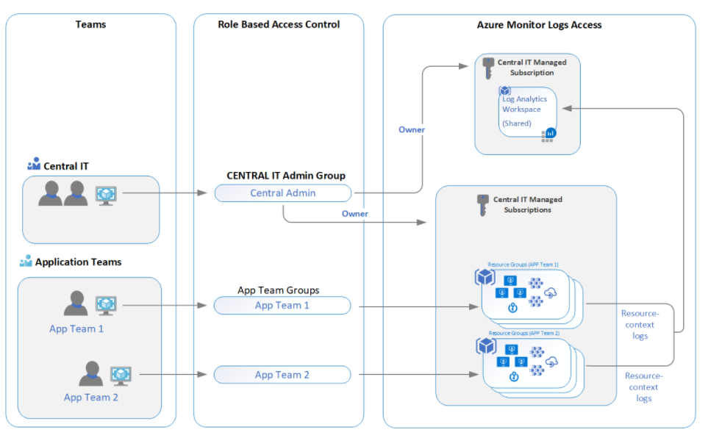
Log Analytics centralized workspace
Notes:
Maria
Wie würde ein szenario dazu aussehen
Hier sehen wir einen workspace, compliance anforderung hier mehrere zu haben und auch keine region anforderung. Fürs platform management zugriff auf den workspace als owner kann alles sehen, application team kann auf die resourcen log zugreifen der resourcen die sie rbac haben
Das ganze kann man auch über policies enforden, dass resourcen ihre logs an diesen workspace schicken, aber darüber wird Robert bald sprechen.

Slide 31
Azure Monitor Log Analytics
Log Analytics for centralized platform management
​Security, networking, Operational (platform health), lenses
​Single Log Analytics workspace except where RBAC and data sovereignty requirements mandate additional workspaces.​
Export logs to Azure Storage if log retention requirements exceed two years
Real-time ingestion latency​​
Use Alerting and Dashboards
Data on Azure stays on Azure​
SIEM Integration​
Design Recommendation
Notes:
Maria
Jetzt haben wir einige der werkzeuge kennengelert, wie azure monitor, log analytics als letzes habe ich ihnen den zentralen gedaken vorgestellt, einen log analytics empfelung, wenn wie lager als die retention zeit speiern in storage, nutzen sie altering und dashboards und stellen sie diese ihren teams zur verfügung, und die klare empfehlung daten die in azure anfallen auch hier zu belassen und nicht in prem zu überführen
Viel theorie, aber wie sieht das ganze in der realität aus? Robert, kannst du uns einige beispiel zeigen

Slide 32
Photo layout 1
Azure Policies &
Azure Security Center
Notes:
Robert

Slide 33

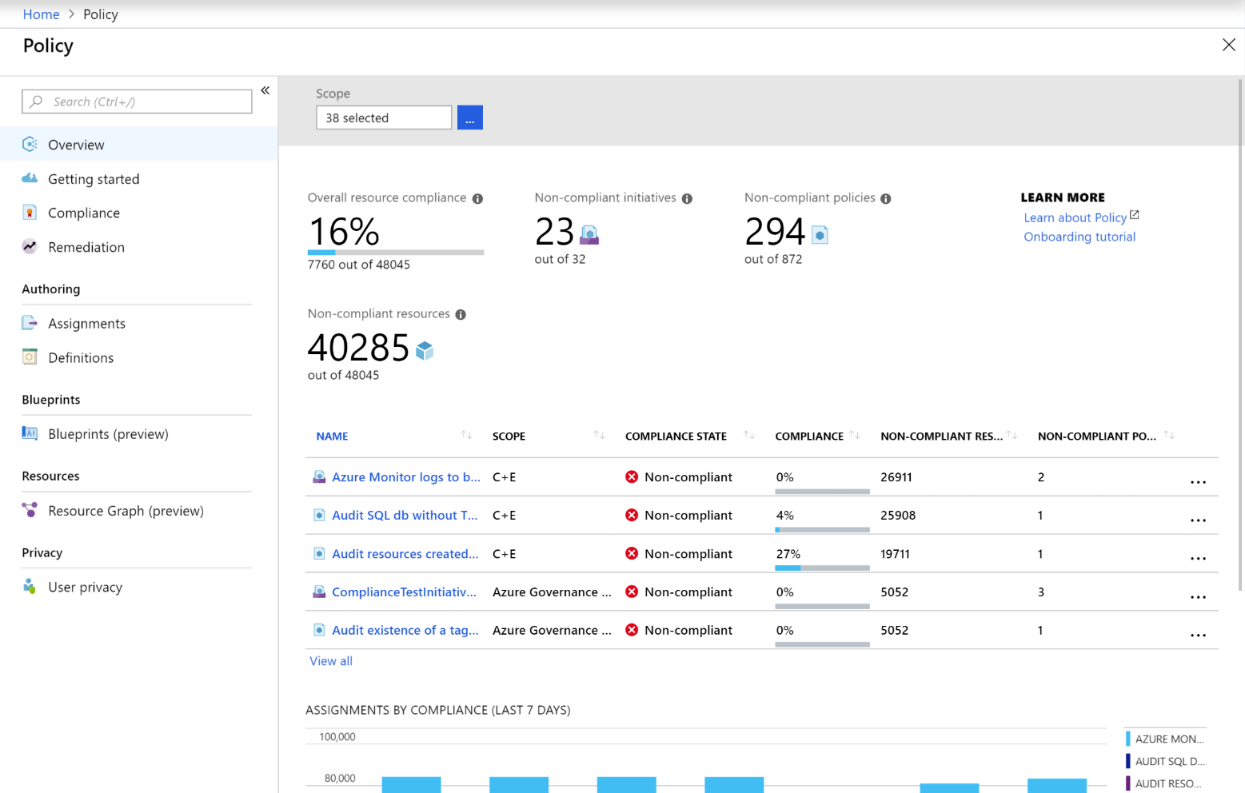
Azure Policy:
guardrails that establish governance model within a specified scope
enforces organizational standards
assess compliance at scale
used for resource consistency, regulatory compliance, security, cost and management
Notes:
Robert

Slide 34
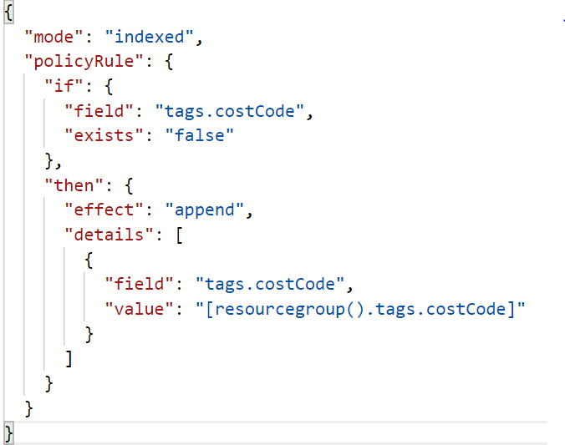
Azure Policy:
Restrict location or resource type (built-in)
Inherit tags from Resource Group (see right ->)
Block ‘open to any’ NSG rule creation
Enable diagnostic logs at-scale
Security (built-in from Azure Security Center & In-Guest)
Notes:
Robert

Slide 35




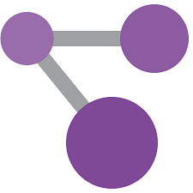

Azure Security:
Microsoft 365
App
Network
IoT
Partner solutions
SQL
Azure Security Center
Access
ASC Connector
Multi-cloud
Azure
Sentinel
SIEM
IoT
Compute
Network
Data
Azure Security Center
Cloud Workload Protection
Azure Sentinel
Cloud Native SIEM
Notes:
Robert
Security Center
Azure Security Center also plays an important part in your monitoring strategy. It can help you monitor the security of your machines, networks, storage, data services, and applications. Security Center provides advanced threat detection by using machine learning and behavioral analytics to help identify active threats targeting your Azure resources. It also provides threat protection that blocks malware or other unwanted code and reduces the surface area exposed to brute force and other network attacks.
When Security Center identifies a threat, it triggers a security alert with steps you need to take to respond to an attack. It also provides a report with information about the threat that was detected.
Azure Security Center's threat protection enables you to detect and prevent threats across a wide variety of services from Infrastructure-as-a-Service (IaaS) layer to Platform-as-a-Service (PaaS) resources in Azure such as IOT and App Service and finally with on-premises virtual machines.
Azure Sentinel delivers intelligent security analytics and threat intelligence across the enterprise, providing a single solution for alert detection, threat visibility, proactive hunting, and threat response. Azure Sentinel is your service operations center (SOC) view across the enterprise, alleviating the stress of increasingly sophisticated attacks, increasing volumes of alerts, and long resolution timeframes.
You can stream threat detection findings from Azure Security Center to Azure Sentinel for investigation, threat hunting, correlation with signals from other security solutions, and security operations center (SOC) level management.
So how does Azure Security Center relate to Azure Sentinel?
Security Center is one of the many sources of threat protection information that Azure Sentinel collects data from, to create a view for the entire organization. Microsoft recommends that customers using Azure use Azure Security Center for threat protection of workloads such as VMs, SQL, Storage, and IoT, in just a few clicks can connect Azure Security Center to Azure Sentinel. Once the Security Center data is in Azure Sentinel, customers can combine that data with other sources like firewalls, users, and devices, for proactive hunting and threat mitigation with advanced querying and the power of artificial intelligence.

Slide 36
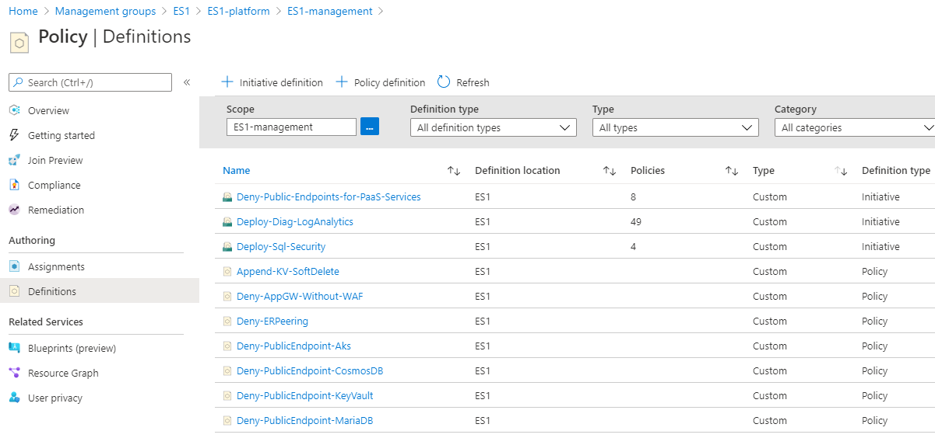
Azure Policies
Use deny policies to supplement Azure role assignments
Management-as-code and Management on by default
Use resource locks to prevent accidental deletion
Design Recommendation
Notes:
Robert
Deploy if not exist um sicherzustellen agents vorhanden, so dass monitoring daten auf jedenfall vorhanden, monitoring by default
Policy Assignment
Policy assignments establish the guard rails that allow for subscription management to be distributed while remaining centrally governed, enabling subscription democratization. Within the context of the Management subscription, the focus of Enterprise-scale is on ensuring the appropriate resources are in place and ready for consumption by platform services and landing zones.
Enterprise-scale policy enforcement includes:
Activity Log for all subscriptions are set to export to Azure Monitor Logs workspace
Resource diagnostic settings for all resources are set to export to Azure Monitor Logs workspace
Azure Monitor for VMs is enabled for all subscriptions
Workbooks provide a comprehensive view into policy actions across the estate.
Design recommendations:
Use Azure Policy for access control and compliance reporting. This provides the ability to enforce organization-wide settings to ensure consistent policy adherence and fast violation detection. For more information, see Understand Azure Policy effects (https://docs.microsoft.com/en-us/azure/governance/policy/concepts/effects)
Use deny policies to supplement Azure AD RBAC assignments. Deny policies are used to prevent deploying and configuring resources that don't match defined standards by preventing the request from being sent to the resource provider. The combination of deny policies and RBAC assignments ensures the appropriate guard rails are in place to enforce who can deploy and configure resources and what resources they can deploy and configure.
Knowledge check:
Which is not an Azure Policy effect:
DeployIfNotExists
Deny
Allow
Audit

Slide 37
Photo layout 1
Azure Automation Accounts
Notes:
Robert
Automation Accounts
Centralized Azure Automation accounts provide application landing zones with easily consumable management services, and they provide central IT with the visibility and control required to ensure compliance with enterprise standards. Integration with Azure Policy ensures resources are configured correctly at time of deployment.
Update Management in Azure Automation can be used to manage operating system updates for Windows and Linux machines in Azure, in on-premises environments, and in other cloud environments.
Inventory Management in Azure Automation provides the ability to collect and view inventory for software, files, Linux daemons, Windows services, and Windows Registry keys on your computers.
Change Tracking in Azure Automation provides insight into changes to Windows software, Linux software packages, Windows and Linux files, Windows registry keys, Microsoft services, and Linux daemons on your computers.

Slide 38
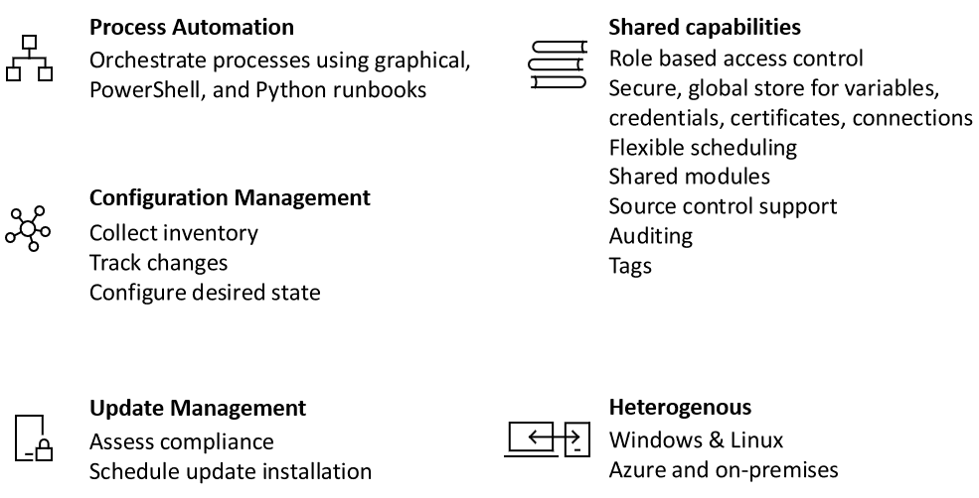
Notes:
Robert

Slide 39
Keep in mind!
Notes:
Maria
Danke für deine ausführung robert, wichtige themen, um den themen komplex und die recommendations des etnerprise scales nochmal zu festigen hier also ncoh einmal die zusammenfassung

Slide 40
Management & Monitoring – Design Recommendations
Use a single monitor logs workspace to manage platforms centrally except where role-based access control (RBAC) and data sovereignty requirements mandate separate workspaces.
Enable workspace configured in resource-centric access control mode, where granular RBAC is enforced to ensure app teams will only have access to the logs from their resources.
Export logs to Azure Storage if log retention requirements exceed two years (Use immutable storage with WORM).
Use Azure Policy for access control and compliance reporting.
Notes:
Maria
Wie am anfang besprochen, fürs zentrale platform management nutzen sie einen log analytixs workspace wenn möglich, resource centric access mode
Wie gesagt, wenn retention dann storage und wie von robert gezeigt nutzen die policys für access control und ihr compliance reporting

Slide 41
Management & Monitoring – Design Recommendations
Use update management in Azure Automation as a long-term patching mechanism for both Windows and Linux VMs.
Use resource locks to prevent accidental deletion of critical shared services.
Include service and resource health events as part of the overall platform monitoring solution.
Do not send raw log entries back to on-premises monitoring systems. Instead, adopt a principle that data born in Azure stays in Azure. If on-premises SIEM integration is required, then send critical alerts instead of logs.
Notes:
Maria
Azure automation gerade gezeigt
Resourcen locks, service health

